Slide 1
Manage secrets and protect sensitive data
-- Dynamic Secrets
Secure, store, and tightly control access to tokens, passwords, certificates, encryption keys for protecting sensitive data, and other secrets in dynamic infrastructure.

Slide 2
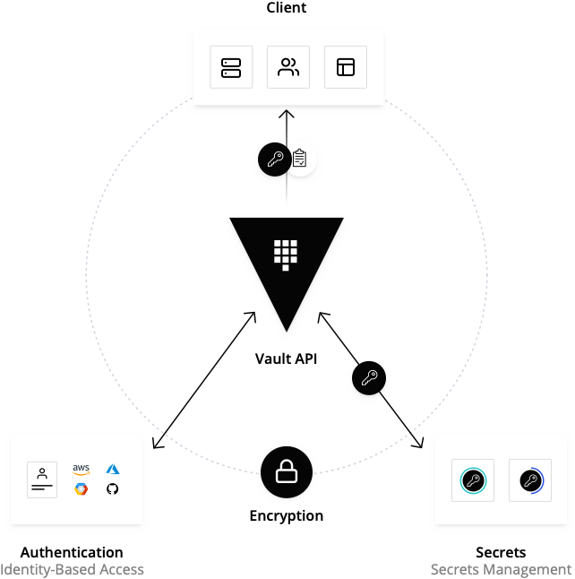
How Vault Works
Vault tightly controls access to secrets and encryption keys by authenticating against trusted sources of identity such as Active Directory, LDAP, and cloud identity platforms. Vault enables fine grained authorization of which users and applications are permitted access to secrets and keys.
VAULT APPROACH TO DYNAMIC INFRASTRUCTURE

Slide 3
Use Case
Secrets Management
VAULT ADOPTION

Slide 4
Secret Storage
Dynamic Secrets
Namespaces
Encrypt and store data in the storage backend of your choice.
Dynamic secrets are ephemeral, programmatically generated when they are accessed and do not exist until they are read, reducing risk of someone stealing them or another client using the same secrets. Dynamic secrets can be revoked immediately after use, minimizing the life of the secret.
ENTERPRISE
Provide secure multi-tenancy with isolated, self-managed environments.
Features
Secure Plugins
Detailed Audit Logs
Lease & Revoke Secrets
Extend Vault with pluggable secret engines such as Consul, MySql, AWS, MongoDB, and more.
Provide detailed history of client interaction — authentication, token creation, secret access & revocation. Logs can be used to detect security breaches, attempted access to systems, and guide policy enforcement
Minimize the impact of secrets exposure by limiting how long credentials can live by creating time-based tokens for automatic or manual revocation and management.
USE CASE: SECRETS MANAGEMENT

Slide 5
Dynamic Secrets
Secret Sprawl
Secrets in plaintext may accidentally be left in an application or with an individual long after the intended period of access.
USE CASE: SECRETS MANAGEMENT

Slide 6
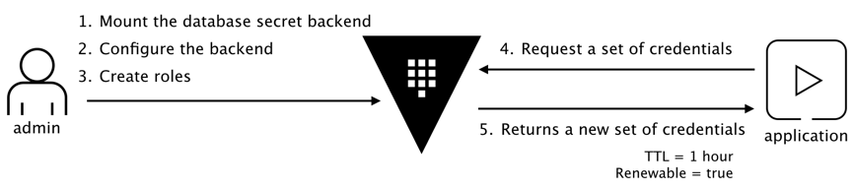
Dynamic Secrets
Dynamic Secrets
Vault grants tokens for access, not credentials, to ensure least privilege with security and ensure break glass functionality
Set expiry to ensure that access is automatically revoked on time
Revoke outstanding access at will
Break glass functionality to halt all access in critical situations
ENTERPRISE
Further control access to secrets with Sentinel policies
USE CASE: SECRETS MANAGEMENT

Slide 7
Dynamic Secrets - Big Ideas
How do Dynamic Secrets Help
Privilege Separation - Separation of privilege refers to the compartmentalization of privileges across various application or system sub-components, tasks, and processes.
Vault Implementation -- Create a specific policy based on role that in this case, compartmentalizes database access
Privilege Bracketing - Elevate privileges on an as-needed basis for specific applications and tasks only for the moment of time they are needed, without requiring administrative credentials or exposing passwords.
Vault Implementation -- Dynamic Secrets that utilize a Time-based “Lease” for access
Non-repudiation - You are who you say you are and it can be audited
Vault Implementation -- Vault provides meta-data and audit logging for traceability
USE CASE: DATA ENCRYPTION

Slide 8
Dynamic Secrets – Kubernetes Integration
Best Practice with Kubernetes
Leverage Kubernetes’ built-in service discovery mechanisms for services running outside the cluster.
Parity across your dev and prod environments
When the service migrates inside the cluster, you don’t have to change your code at all.
USE CASE: DATA ENCRYPTION

Slide 9
Dynamic Secrets – Kubernetes Integration
Create a service
kind: Service
apiVersion: v1
metadata:
name: mongo
Spec:
type: ClusterIP
ports:
- port: 27017
targetPort: 27017
There are no Pod selectors for this service. This creates a service, but it doesn’t know where to send the traffic. This allows you to manually create an Endpoints object that will receive traffic from this service

Slide 10
Dynamic Secrets – Kubernetes Integration
Create an Endpoint
kind: Endpoints
apiVersion: v1
metadata:
name: mongo
subsets: - addresses:
- ip: 10.240.0.4
ports:
- port: 27017
You can see that the Endpoints manually defines the IP address for the database, and it uses the same name as the service. Kubernetes uses the IP address defined in the Endpoint as if they were a regular Kubernetes Pods.

Slide 11
Demonstration
Dynamic Secrets
VAULT ADOPTION

